Slide 1

https://www.addictioncampuses.com/alcohol/related-crimes/
Notes:
Shay - Just announce the project

Slide 2

CRIMES AND ALCOHOL
VINCE BRUNO
SHAY KING
LONNY KRAMER
BROOKLYN PAYNE
https://www.123rf.com/photo_10160845_yellow-crime-scene-tape-on-white-background.html
Notes:
Shay - introduce the group

Slide 3
MOTIVATION & SUMMARY
Motivation:
We wanted to know if the availability of packaged liquor had a correlation with crimes within 18 zip codes in the City of St. Louis.
Core message:
Hypothesis:
If there is more availability of packaged liquor, then there will be more crimes.
Null Hypothesis:
If there is less availability of packaged liquor, then there will be less crime.
Notes:
Shay - give an overview of the theme and what we were trying to show

Slide 4
https://giphy.com/gifs/drinking-drink-futurama-okSWjaytQ7Nm0

Slide 5
DATA SOURCES
Finding how much crime in the City of St. Louis
Used http://www.slmpd.org/Crimereports.shtml for crime data csv
Represents first 7 months of 2019
The amount of liquor stores in each zip code we got from the crime data.
used the Yelp.com API
How much crime is affected by the population size
used http://www.slmpd.org/Crimereports.shtml
How crime is affected by location
used http://www.slmpd.org/Crimereports.shtml & Google Maps for zip codes.
Notes:
Shay - quick run through of our data sources

Slide 6
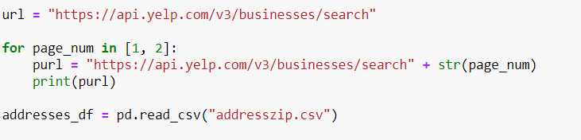
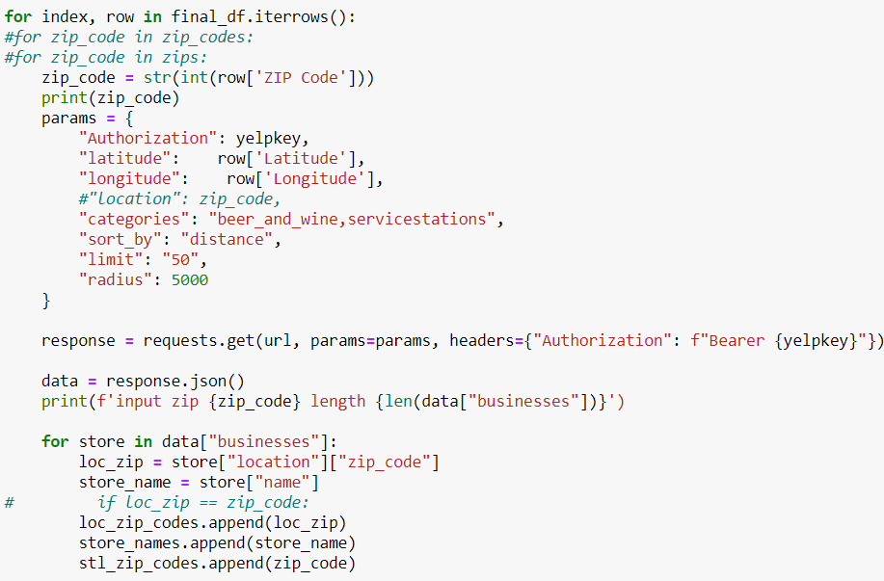

Slide 7
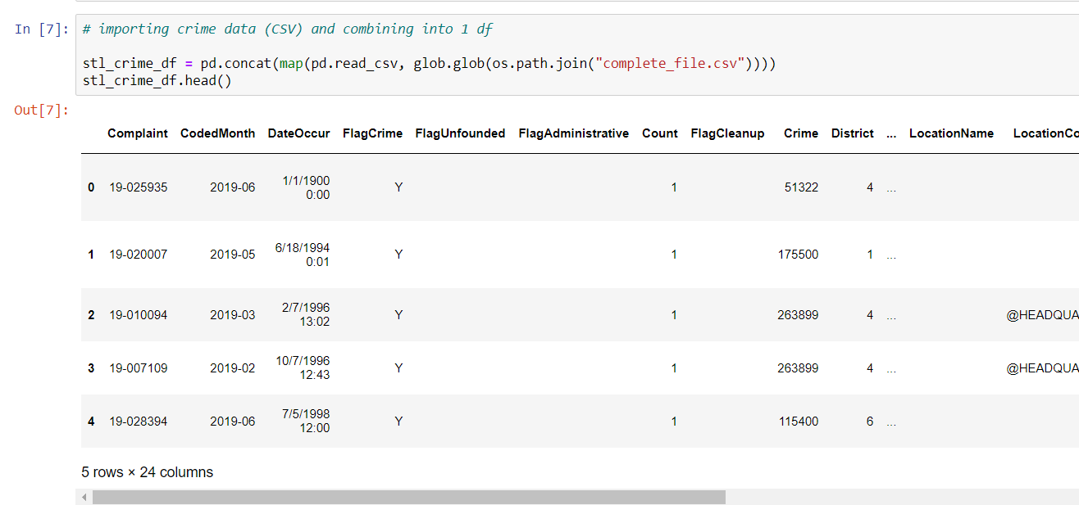
CODE

Slide 8
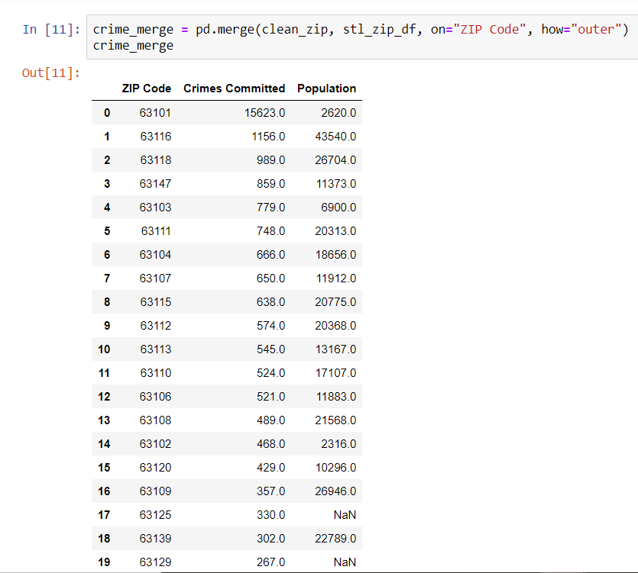
CODE

Slide 9
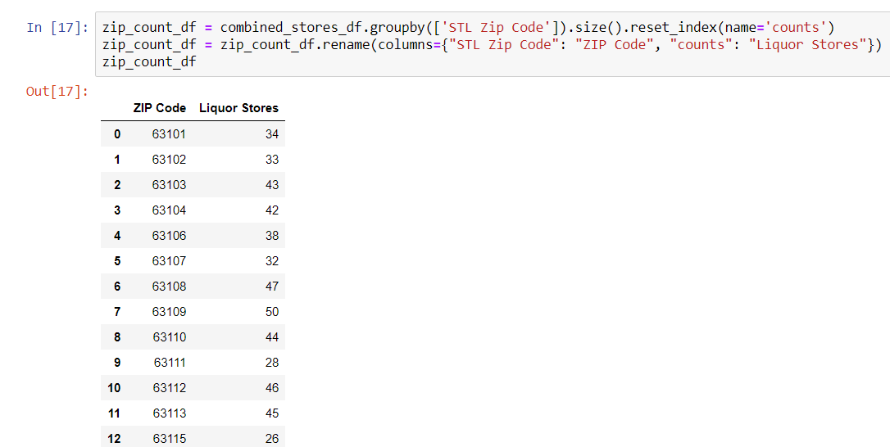
CODE

Slide 10
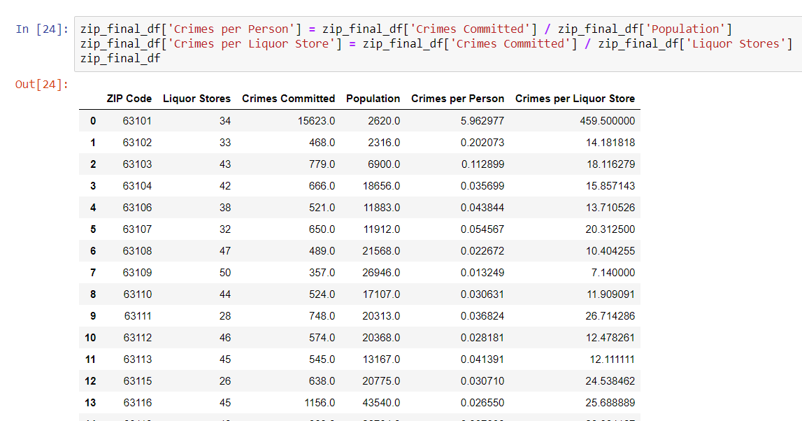
CODE

Slide 11
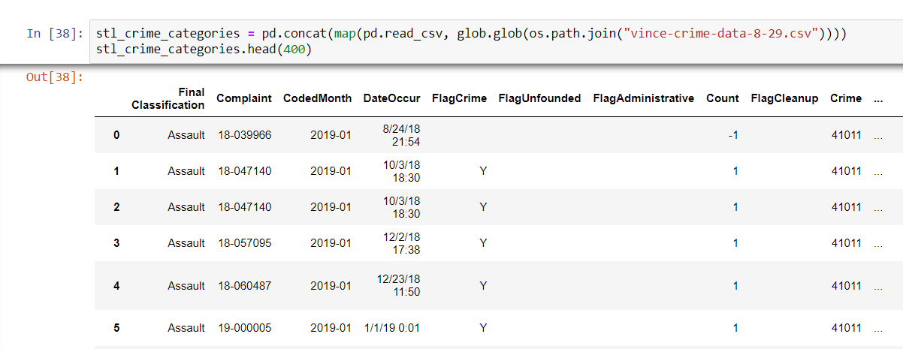
CODE

Slide 12
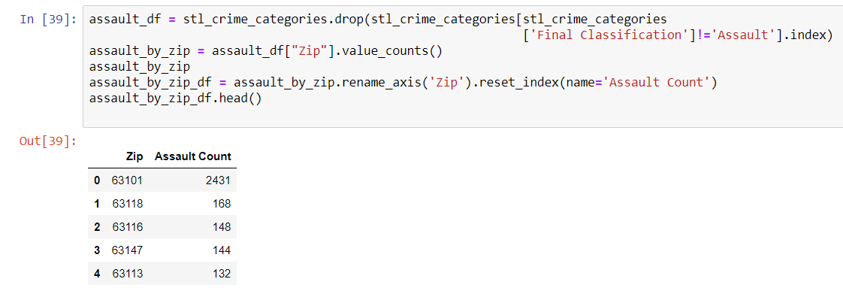
CODE

Slide 13
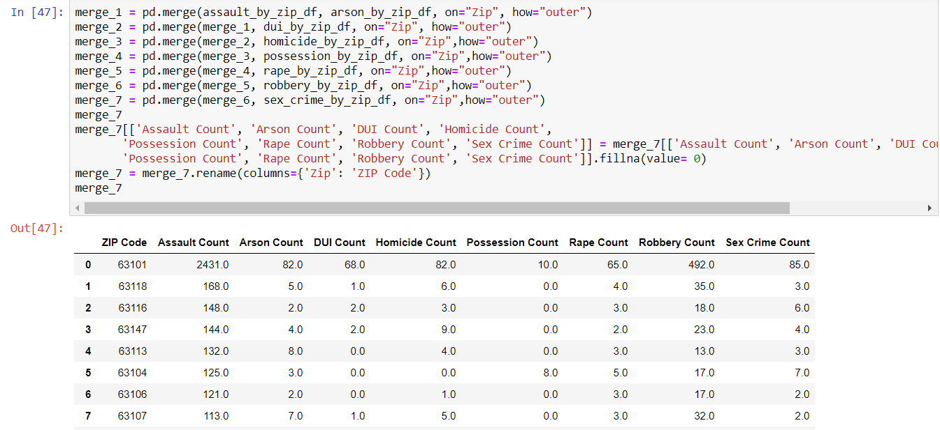
CODE

Slide 14
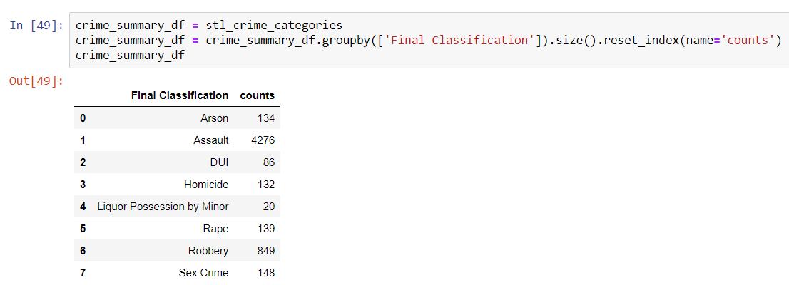
CODE

Slide 15
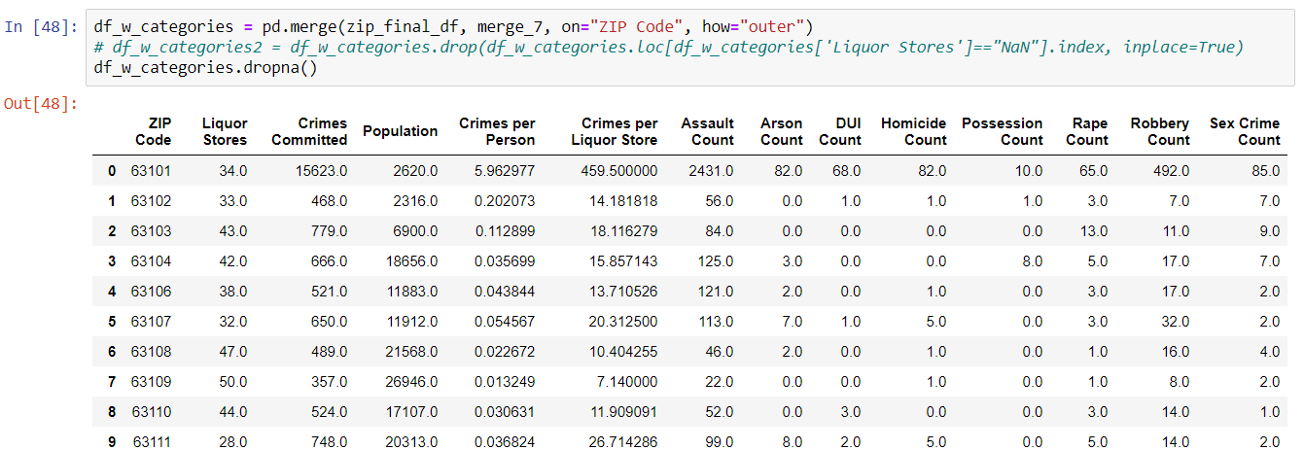
CODE

Slide 16
QUESTIONS TO ANSWER
Are there more crimes in the areas with more liquor stores?
Are there more crimes in the areas with larger population?
Are there more liquor stores in locations with large populations?
Notes:
Vince

Slide 17
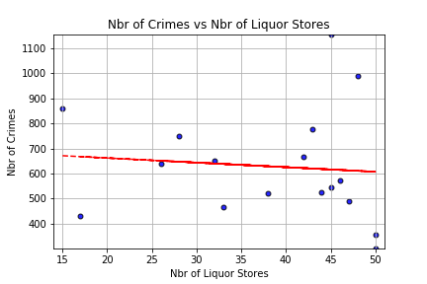
QUESTION 1. DATA ANALYSIS
Are there more crimes in the areas with more liquor stores?
Slope = -0.13504
r2 = 0.00832
Notes:
Vince - 1 - Evident that there is no correlation between the number of crimes and the number of liquor stores
2 - slope of the line is downward which means that as the number of liquor stores increase, there is actually slightly less crime in that given area
3 - The r2 is about 0.8% which tells us that the data has a very weak relationship (63116 and 63118 are noteworthy as these do have relatively high liquor store counts (45 and 48, respectively)

Slide 18
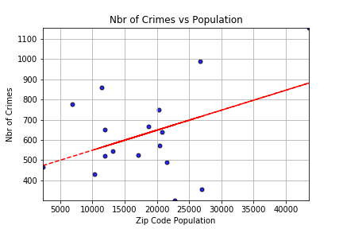
QUESTION 2. DATA ANALYSIS
Are there more crimes in the areas with larger population?
Slope = 0.10421
r2 = 0.17616
Notes:
Vince - 1 - some correlation between the population size and number of crimes
2 - slope of the line is upward which means that as the population increases, there is typically more crime in the area
3 - The r2 is about 17.6% which tells us that the data has a weak relationship, but there is still a slight relationship (63116 is driving this line upward (Tower Grove South, Bevo, and Dutchtown neigborhoods) so is 63118 (Tower Grove East, etc - adjacent to 63116)

Slide 19
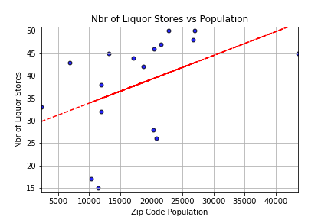
QUESTION 3. DATA ANALYSIS
Are there more liquor stores in locations with large populations?
Slope = 0.19069
r2 = 0.20439
Notes:
Vince - 1 - some correlation between the number of liquor stores and ZIP population
2 - slope of the line is upward which means that as the population increases, there are typically more liquor stores in the area (expected)
3 - The r2 is about 20.4% which tells us that the data has a weak relationship, but there is still a slight relationship

Slide 20
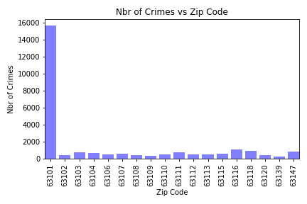
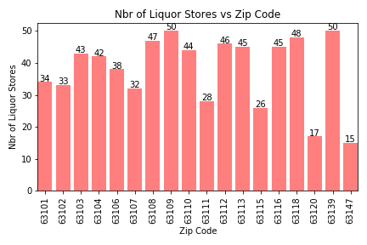
ADDITIONAL CHARTS
Notes:
1 - Interesting charts to show the amount of crime and number of liquor stores by zip code
a - 63101 (downtown) has by far the most reported crime. most of these are larceny and assault related

Slide 21
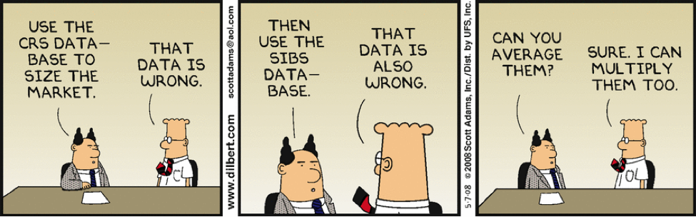
DATA CLEANUP & EXPLORATION

Slide 22
DATA CLEANUP & EXPLORATION
The St. Louis City municipality data contained St. Louis County data that we did not need.
Addresses were incomplete (not having zipcodes)
Within the Yelp API we were searching for liquor stores, but needed to widen our scope to beer, wine and service stations.
We searched for available packaged liquor by zip codes but needed to use Latitude and Longitude for a more accurate location.
We picked a range of 5000 meters (3 miles) from the center of the zip code.

Slide 23
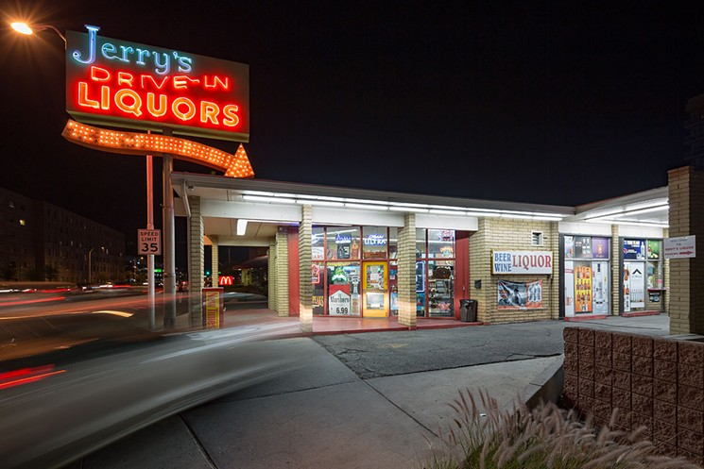
DISCUSSION
https://www.phoenixnewtimes.com/restaurants/a-field-guide-to-drive-thru-liquor-stores-in-metro-phoenix-9219759

Slide 24
POST MORTEM

Slide 25
DIFFICULTIES
Finding APIs and CSVs with enough data.
Taking the CSV files we found and separating the information we needed from the information we didn’t need. Consolidating
Within the API, making sure we were calling out the correct type of data we were looking for, ie:
instead of liquor stores, we used: beer, wine and service station.
using a more defined scope by using Latitude and Longitude.
Finding crime data by zip code
data didn’t include any zip codes and not always full addresses.
How to loop through pages….we ignored it :)
Notes:
Lonny: 1) couldn’t stay within zip codes exclusively
2) STL county crime data was included from metro records
3) we used the lat/long to start our radius search from the center of the zip code
4) searched for pagination, but we couldn’t get it to work. we lowered the radius to minimize pagination and used what we could pull

Slide 26
ADDITIONAL INFORMATION WITH MORE TIME
the number of violent crimes by how many liquor stores there are
how many car accidents by how many liquor stores
diving deeper into the data and finding specific crimes by location or how many liquor stores there are.
Notes:
Lonny: 1) with infinite amount of time on the project we could have done a deeper dive on the crime type data

Slide 27
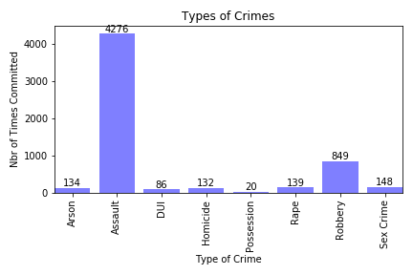
ADDITIONAL INFORMATION

Slide 28
QUESTIONS?

